Slide 1
Machine Learning
South Fayette Pilot

Slide 2
Selling your idea
In the weighted majority algorithm, we learned about online learning which can take multiple datapoints and adjust weights so that it can predict which friend may have the closest tastes in movies to your own.
Now let’s look at a different applications of weights.

Slide 3

Selling your idea
Problem:
How would one classify this handwritten digit? It’s not very well written and the resolution of the image is low.

Slide 4
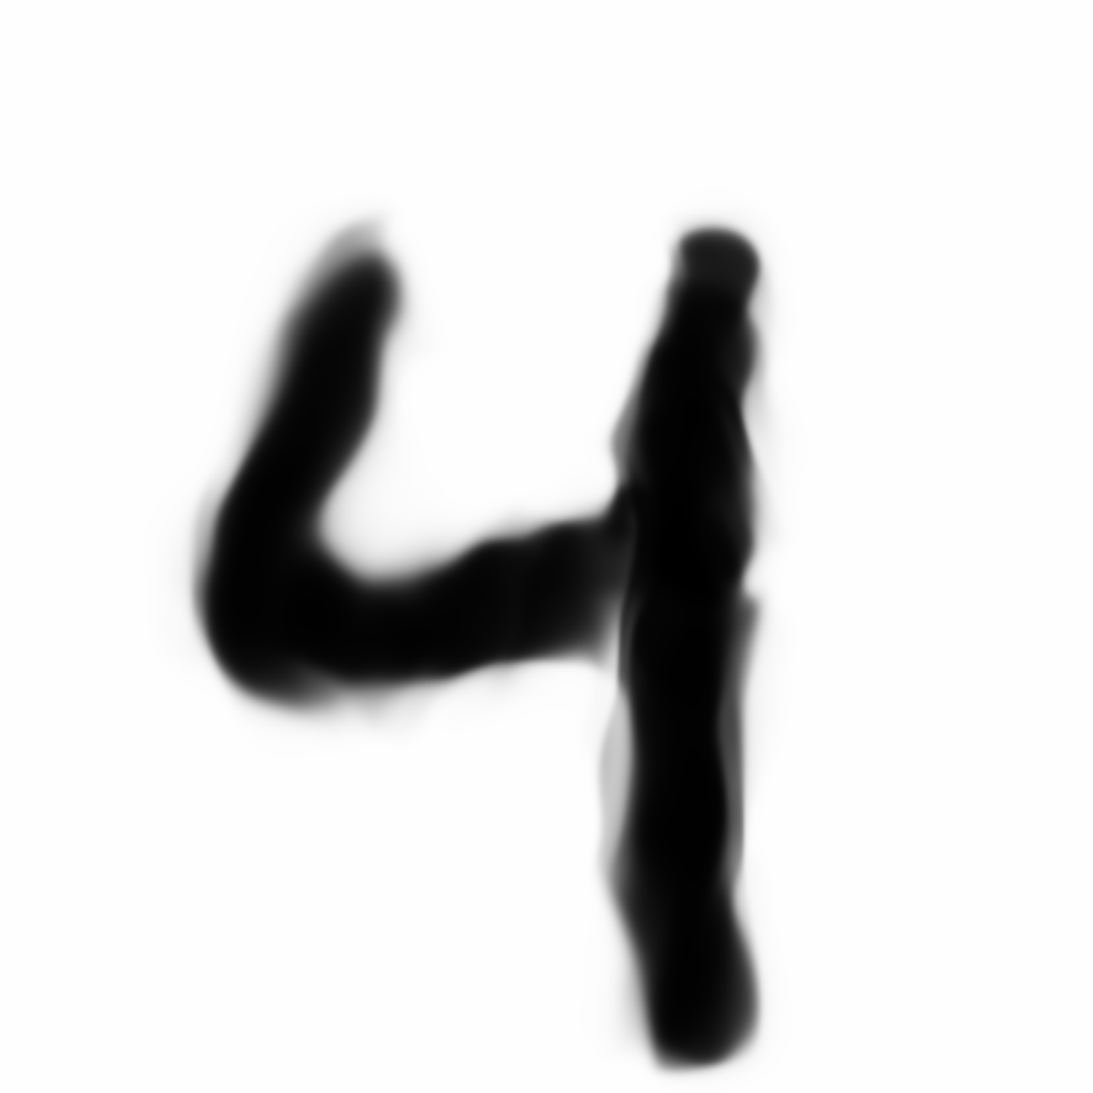
Selling your idea
You can look at this from pixel values.
The image is composed of 28 x 28 pixels.
Our brain takes these 28 x 28 pixels (784 pixels) and understands it as a “4”.
28
28

Slide 5
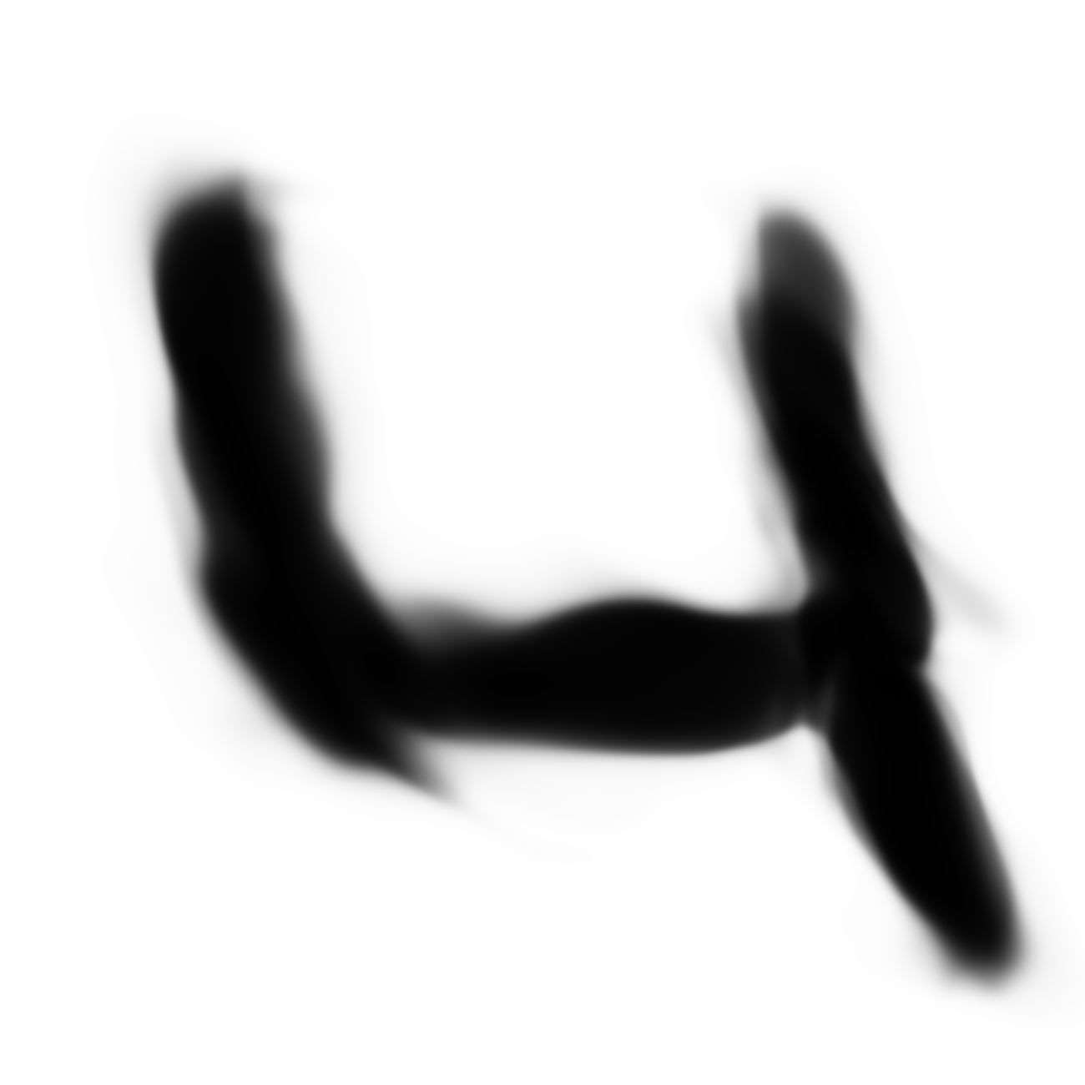
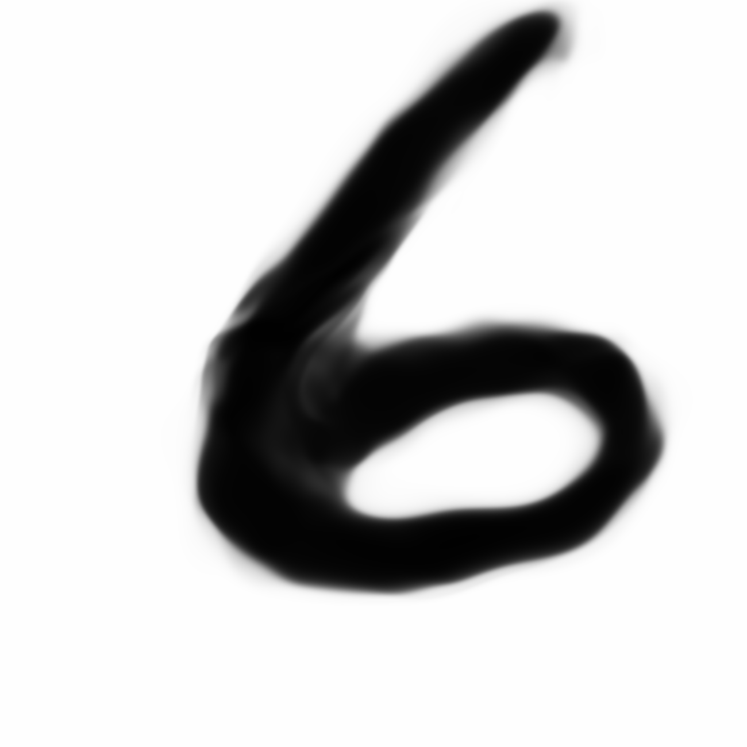
But look at these others.
It seems fairly obvious to the human eye and brain that these are all “4” but the pixel values are very different. The neurons in our brain firing for each “4” are different than the others but the brain understands them all the same. They very obviously can see the rightmost is a “6”
Selling your idea
=
=
≠

Slide 6
Selling your idea
The algorithm we will use, a neural network
will try to solve this mystery and problem.
28
0
1
2
3
4
5
6
7
8
9
Neural
Network
28

Slide 7
Selling your idea
It must be stated that neural networks can be used to solve many problems. This is just one example.
28
0
1
2
3
4
5
6
7
8
9
Neural
Network
28

Slide 8
The algorithm we will use, a neural network, will take in the 28x28 grid of pixels, stack them into an array and output a prediction of class 0-9… one class for each digit.

Slide 9
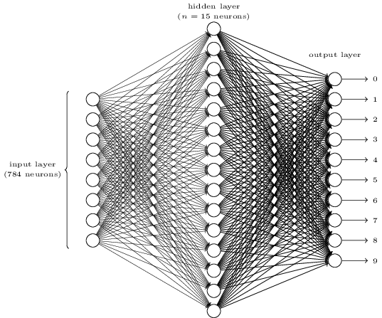
Let’s see what a neural network actually is and how it actually makes this prediction.
28
28

Slide 10
The hope is that you will understand the structure and the reason why they work.
28
28

Slide 11
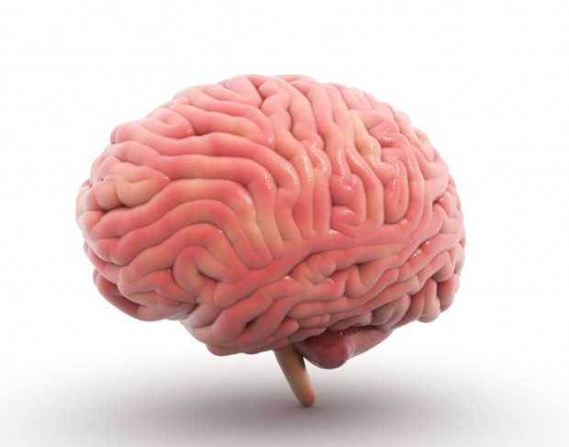
On a broad level, neural networks are composed of layers of neurons and draw influence by way the brain works.
28
1
a layer
2
1
3
2
...
3
28
4
5
6
a neuron
7
...
8
783
9
784
10

Slide 12
In this case, the hope is that after the 784 (28x28) pixels go into the Neural network as 784 input neurons the correct output of “4” is predicted of the 10 output neurons.
It is important to note that this design of a neural network is specific to this problem.
28
1
a layer
output
input
2
1
3
2
...
3
28
4
5
6
a neuron
7
...
8
783
9
784
10

Slide 13
But how are these neurons and layers linked together? What exactly is in a neuron? And how are they all connected like in the picture?
28
1
a layer
2
1
3
2
...
3
28
4
5
6
a neuron
7
...
8
783
9
784
10

Slide 14
At first, you can simply think of a neuron as something that holds a number between 0 and 1. This value is called an “activation”. The idea is that the neuron is “lit up” if the “activation” is a high enough number.
So for the 784 pixels, the “activations” held in the
corresponding 784 input neurons are the grayscale
values between 0 and 1.
.48
1
2
1
3
2
28
...
3
.08
4
5
28
6
.95
7
...
The “activations” at the output 10 neurons represent how much the neural network believes it is that corresponding digit. 1 for absolutely sure. 0.0 for the opposite.
8
783
9
784
10

Slide 15
As you can see there are two “hidden layers” between the input layer and the output layer. The amount of “hidden layers” is chosen by the programmer as are the number of neurons in each layer.
An important idea is that the activations of the
previous layer’s neurons directly affect the
activations of the subsequent layer’s neurons.
.48
1
2
1
3
2
28
...
3
.08
4
5
28
6
.95
7
...
8
783
9
784
10

Slide 16
So the “activations” for a 4 digit propagate through the middle layers in a manner that the 4 output neuron gets the highest activation at the end.
28
1
2
1
3
2
...
3
28
4
5
6
7
...
8
783
9
784
10

Slide 17

And in this example the “activations” for a 7 digit propagate through the middle layers in a manner that the 7 output neuron gets the highest activation. So the input 784 pixel values causes a ripple effect that somehow makes the 7 output the highest.
28
1
a layer
2
1
3
2
...
3
28
4
5
6
a neuron
7
...
8
783
9
784
10

Slide 18
Note that this network is already trained. That means that if we put in a digit 0-9, the neural network will give the highest activation of the output for that digit. We will learn later how to train this network later.
28
1
a layer
2
1
3
2
...
3
28
4
5
6
a neuron
7
...
8
783
9
784
10

Slide 19
First, why should we hope though that this structure of neurons and layers thinks intelligently? What are we expecting these layers and neurons to be doing?
28
1
a layer
2
1
3
2
...
3
28
4
5
6
a neuron
7
...
8
783
9
784
10

Slide 20
When we look at a digit, we broadly see that for instance that the digits break down into parts.
=
+
=
+

Slide 21
And we can see that even this components can be broken down into even smaller edges.
=
+
+
V b
V b

Slide 22
Ideally, this network in the layer before the output would represent these small edges with all of the activated edges adding up to a 7. The next hidden layer would represent combinations of edges...until finally we get to the full 7 at the end.
1
a layer
V b
2
1
3
2
...
3
4
5
V b
6
7
...
8
783
9
784
10

Slide 23
Of course this idea of breaking things down into smaller and smaller abstraction and adding them up work for other uses of neural networks. Audio for instance. In an audio classifying neural network, the first hidden layer should be sounds, the second syllables, perhaps a third with words etc.
1
a layer
V b
2
1
3
2
...
3
4
5
V b
6
7
...
8
783
9
784
10

Slide 24
We won’t go over the math in detail.
1
a layer
V b
2
1
3
2
...
3
4
5
V b
6
7
...
8
783
9
784
10
Notes:
In reality from start to finish, each one of the neurons is initially assigned to a random number between 0 and 1. Each connection line represents a weight between 0 and 1 which is multiplied by the previous neuron’s activation value. A random output will get the highest number. If it is wrong all of the weights and biases going back get adjusted. With more and more misclassified numbers and adjustments the neural network eventually learns.

Slide 25
This is just a basic neural network.
Cons:
Computationally Expensive.
Classification Boundaries are Hard to understand Intuitively.
Pros:
Great for nonlinear data with a large amount of input features.
1
a layer
2
1
3
2
...
3
4
5
6
7
...
8
783
9
784
10

Slide 26
This just a basic neural “shallow” neural network. There are now more complicated models and applications.
Also, now they are more and more used as part of a problem with stronger statistical backing as opposed to a solitary black box.
1
a layer
2
1
3
2
...
3
4
5
6
7
...
8
783
9
784
10

Slide 27
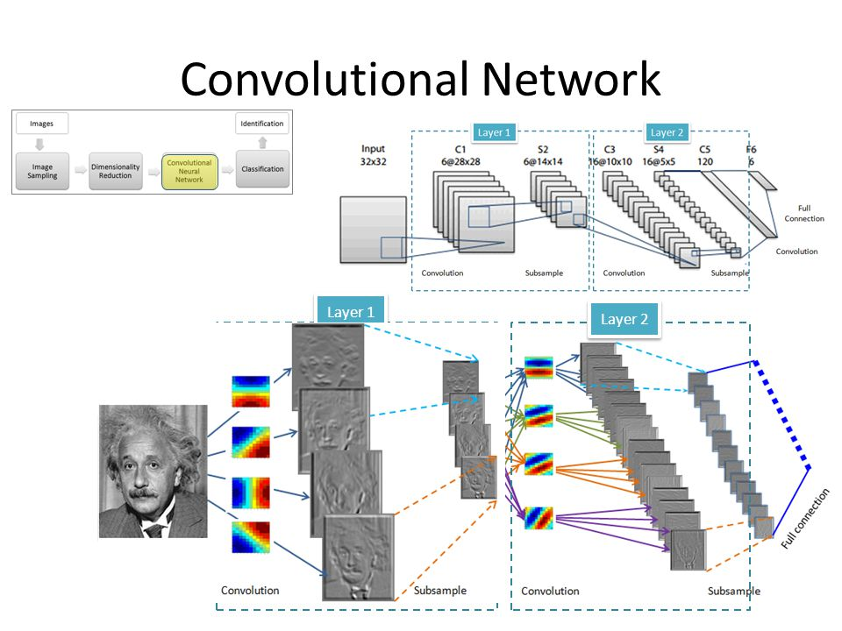

Convolutional Neural Networks (CNNs) have additional types of layers and ways of activating for better image detection.

Slide 28
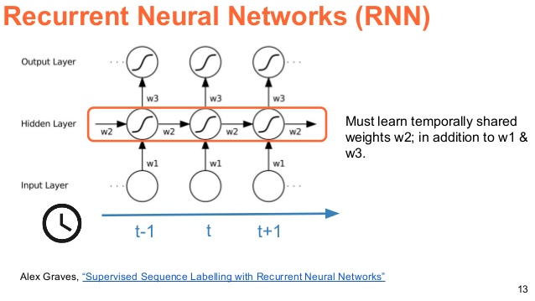
Recurrent Neural Networks (RNNs) and LSTMs are great for sequential problems like translation since they have timesteps and an option to remember or forget a previous timestep input.

Slide 29
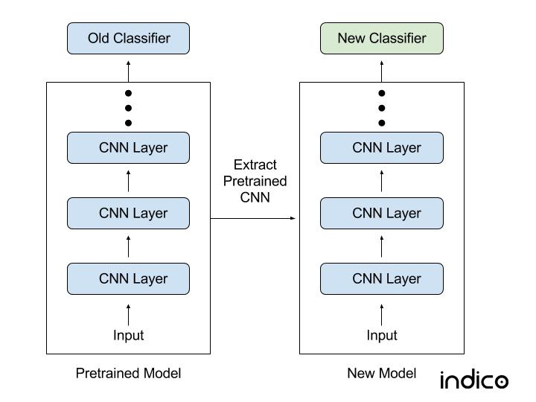
Transfer Learning is an approach to machine learning that applies CNNs and RNNs to NEW problems where you don’t have a lot of data to train on. For instance, if you had 1,000,000 images to train a CNN to classify people, dogs and cats but only 1000 MRI images to find tumors. You can train on the first 1,000,000 images and then transfer all layers except for last and start training on the mri images. This could create an effective classifier
This can also be used in RNNs in SIRI or Amazon Echo for wakewords or trigger words.

Slide 30
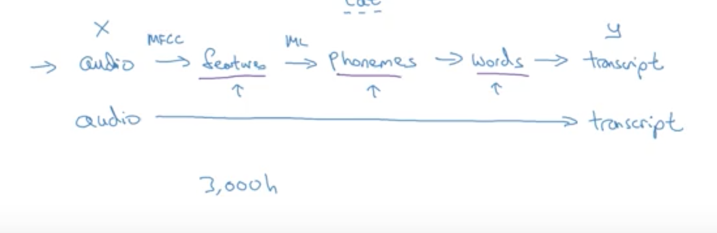
End-To-End Learning is an approach where a problem requires multiple stages of processing. In classical approaches where many different small problems are solved in succession to solve a big problem, one can now create one very very big neural network. An example taking a transcript from audio is to the right. This usually requires a tremendous amount of data.

Slide 31


End-To-End Learning is an approach where a problem requires multiple stages of processing. Conversely, as opposed to a single Deep Neural Network trained to accomplish a task, it can be broken down into multiple smaller tasks that are easier.
In a facial recognition turnstile to the right, as opposed to mapping an image of an employee to an identity, these algorithms first find a face in an image and then map the face to an identity of a person.

Slide 32
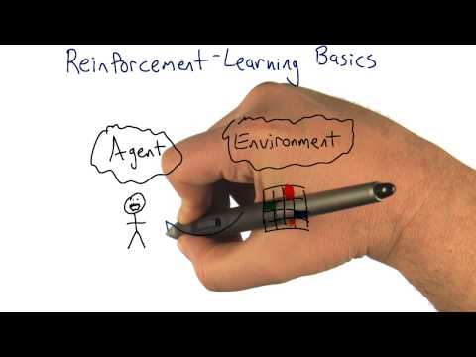
Reinforcement learning (RL) is an optimal control policy where an agent learns to develop an optimal policy of sequential actions by interacting with an environment with rewards and punishments.

Slide 33
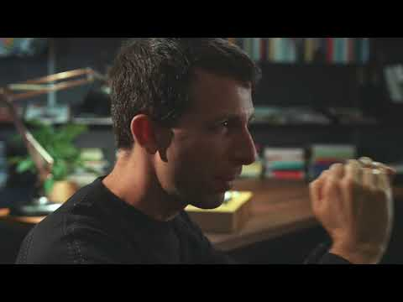
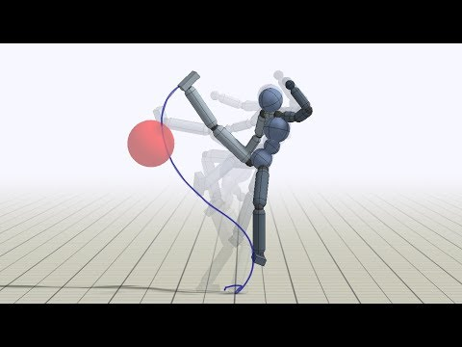
Deep Reinforcement Learning is the applications of Deep Learning to Reinforcement Learning. Deep Reinforcement Learning is when a Deep Learning Neural Network is applied to learn an optimal function that approximates values between steps. In Atari games for instance there are so many different states that a look-up table or linear equation is not as efficient or effective.

Slide 34
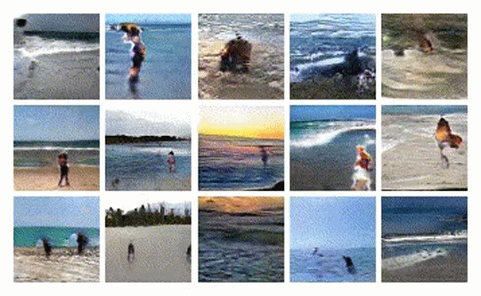
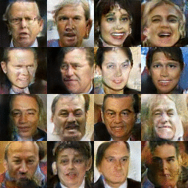
Generative Models are another recent development. They include Variational AutoEncoders (VAEs) and Generative Adversarial Networks (GANS). With Generative Adversarial Networks for instance with a word and a still photograph, it can hallucinate a video of a few frames forward. The word input for the right example is “beach”.
With Variational Autoencoders, and frontal facial images, it can predict side and backviews of the head and other variations.

Slide 35
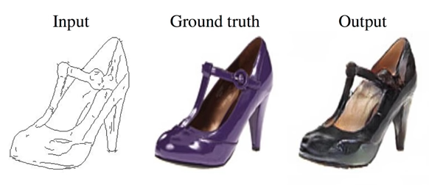
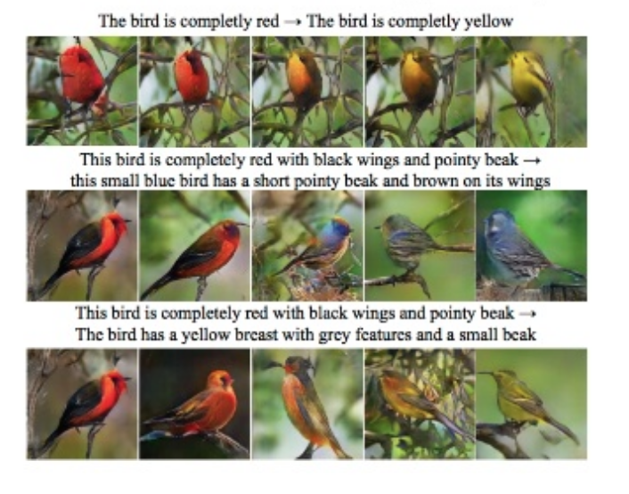
Generative Models
In this GAN on the right, from a drawing, the model can create a real-life rendering of a shoe.
In this StackGan on the right, the model can generate an accurate image from a descriptive sentence.

